Slide 1
[NAME OF STUDENT]
[Student]
Portfolio
[DATE CREATED]
[NAME OF PRIMARY SCHOOL]

Slide 2
What I’ve accomplished
[NAME OF STUDENT]
(Motivation) Good morning, everyone. My name is [Your Name], and today I'm excited to present my amazing project developed using Pygame. The motivation behind this project was to create an interactive and educational game that enhances children's mathematical skills while making learning fun and engaging.
(Define Problem) My problem statement is to design a game that tests kids' reactions to solve basic math problems. The aim is to create an enjoyable learning experience that reinforces fundamental arithmetic skills and quick thinking.
(Ideate Approach) To address this challenge, I ideated a concept where mathematical problems would appear on the screen, ranging from addition and subtraction to multiplication and division. The players' task is to solve these problems as quickly as possible, promoting rapid cognitive processing and mathematical proficiency. Incorporating a scoring system, the game rewards accuracy and speed, adding an element of excitement.
(Create Solution) Leveraging the Pygame library, I implemented the solution, featuring a dynamic spawning mechanism for math problems and an interactive user interface. Correctly solved problems earn points, while a timer intensifies the challenge. Players progress through levels by solving a set number of problems within the given time or achieving a high score. The game also includes a defined game over condition to provide feedback and encourage replayability. The result is a functional and visually appealing game that aligns with the initial goal of providing an enjoyable learning experience for children.
2
Notes:
Poppins Light – 18 size

Slide 3
[NAME OF STUDENT]
Process Flow
Create an interactive game to test kids' reactions in identifying basic mathematical operations.
Define Problem
Develop a concept where simple math problems are presented, and the player needs to quickly solve and select the correct answer.
Ideate Approach
Using Pygame, design a main game loop where basic math problems appear. Players gain points for accurately solving and selecting the correct answers within a time constraint. Increase difficulty gradually by introducing more complex mathematical operations.
Create
Solution
3
Notes:
Poppins Light – 18 size

Slide 4
[NAME OF STUDENT]
State Flow
Scoreboard
This flowchart shows how the transition between the different states. For instance, after seeing the scoreboard, players can choose to start their game and it will naturally move from ready to question to answer for the player to write an answer. Results will be shown immediately. A final winner screen will show who won the game.
Ready
Gameplay
Result
Winner
4
Notes:
Poppins Light – 18 size

Slide 5
[NAME OF STUDENT]
Python Concept
Pygame is a set of Python modules designed for writing video games. It provides functionality for creating windows, handling events like key presses, and drawing graphics on the screen.
Pygame
Random library provides functions for generating random numbers. This can be useful for scenarios where randomness is required, such as selecting questions or shuffling elements in a game.
Random
Time.sleep() function causes the program to pause for a specified number of seconds. It's commonly used to introduce delays in code execution, which can be useful in scenarios like creating countdowns or simulating time-based events.
Time.Sleep
5
Notes:
Poppins Light – 18 size

Slide 6
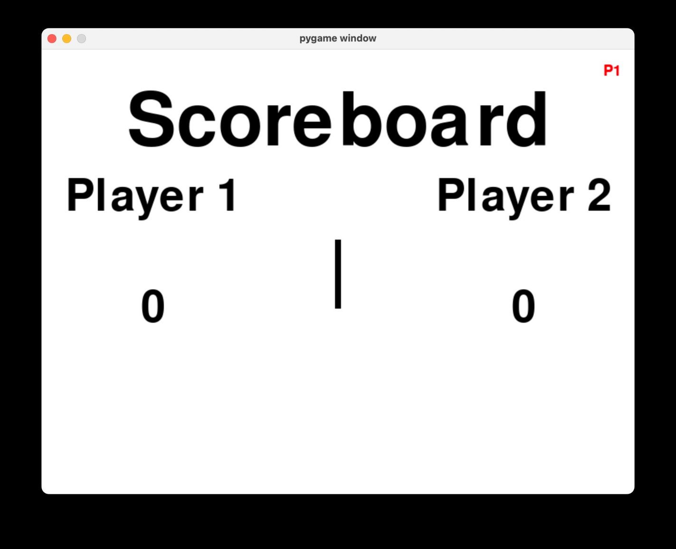
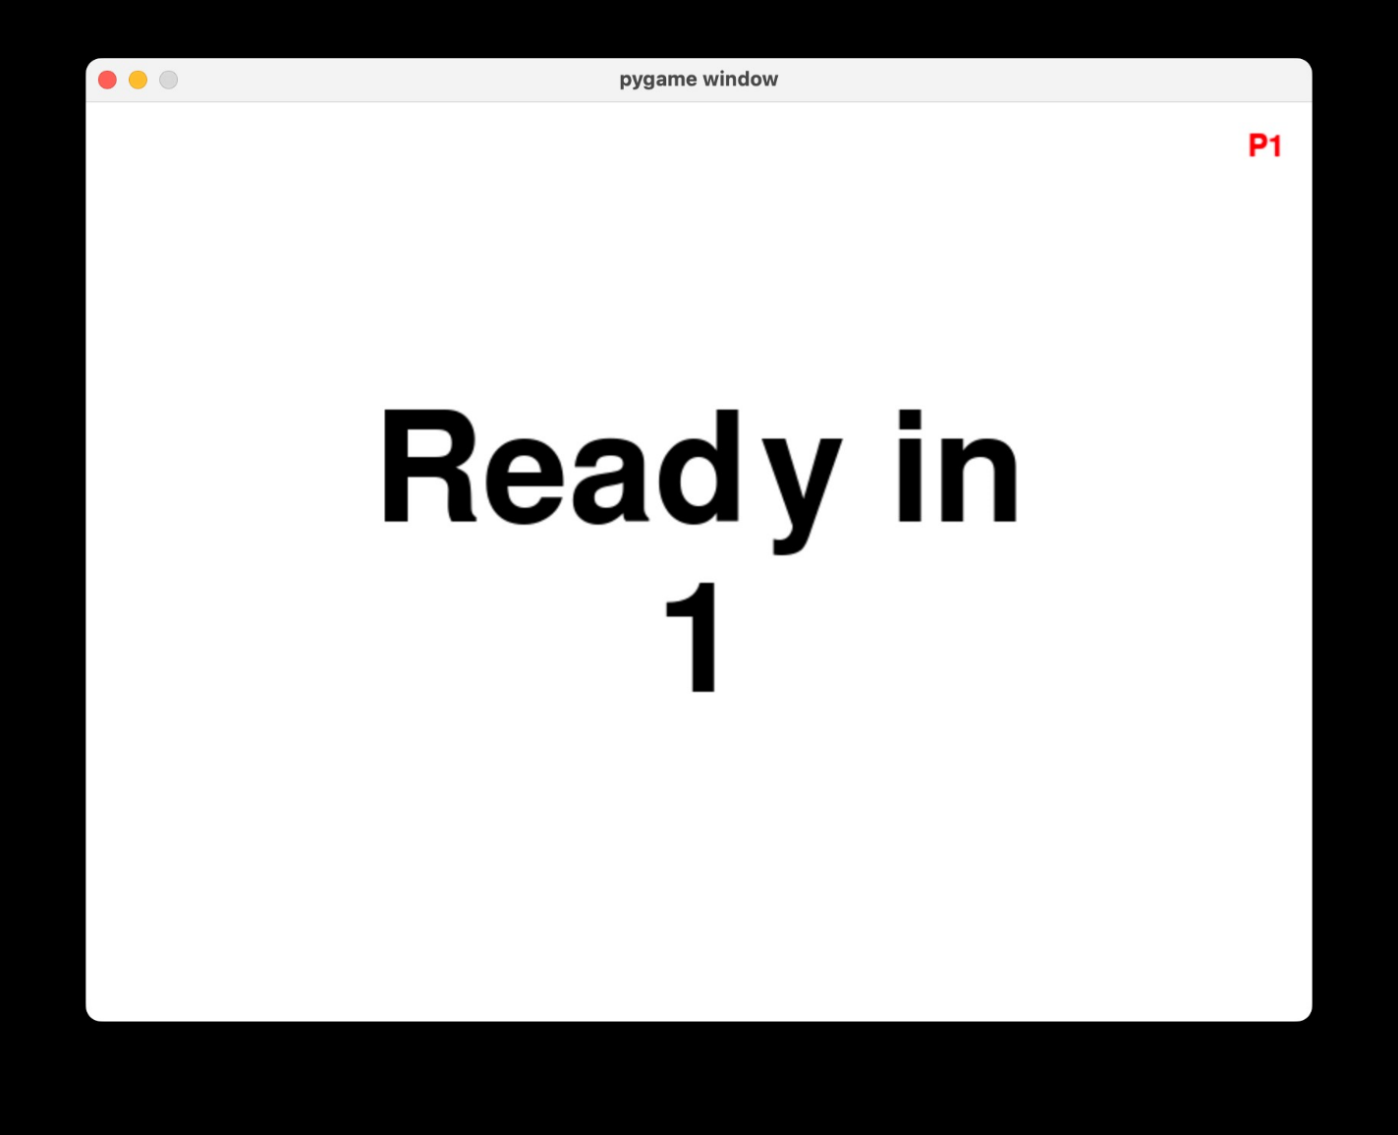
[NAME OF STUDENT]
Mock Screens
Ready In
1
Description
Description
Scoreboard Screen
Ready Screen
6
Notes:
Poppins Light – 18 size

Slide 7
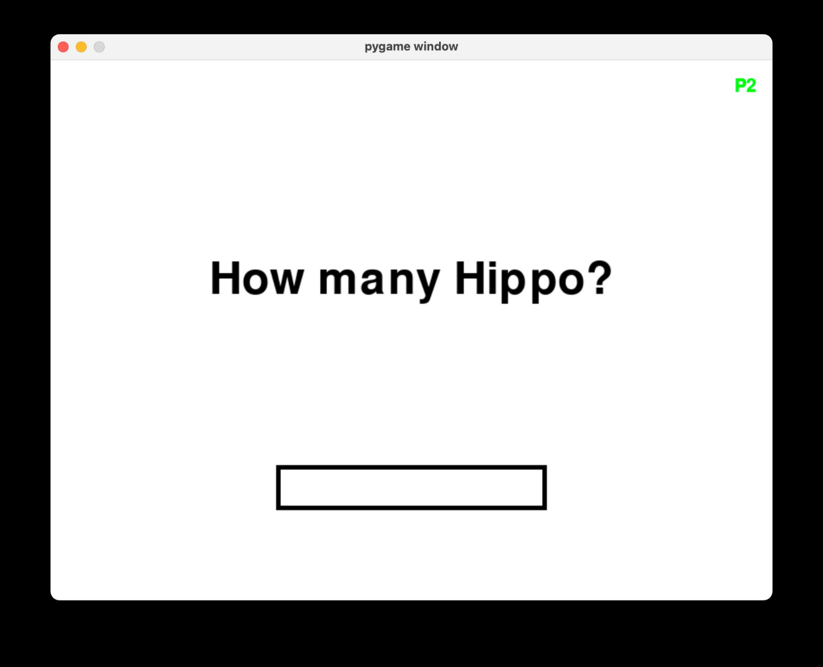
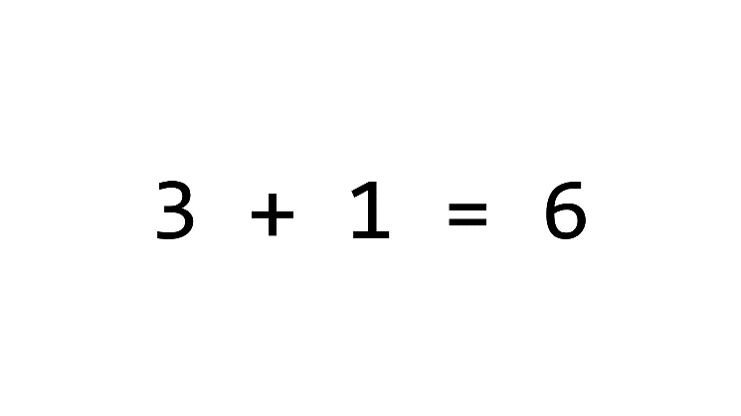
[NAME OF STUDENT]
Mock Screens
Score: 0
Time: 100
Description
Gameplay Screen
7
Notes:
Poppins Light – 18 size

Slide 8
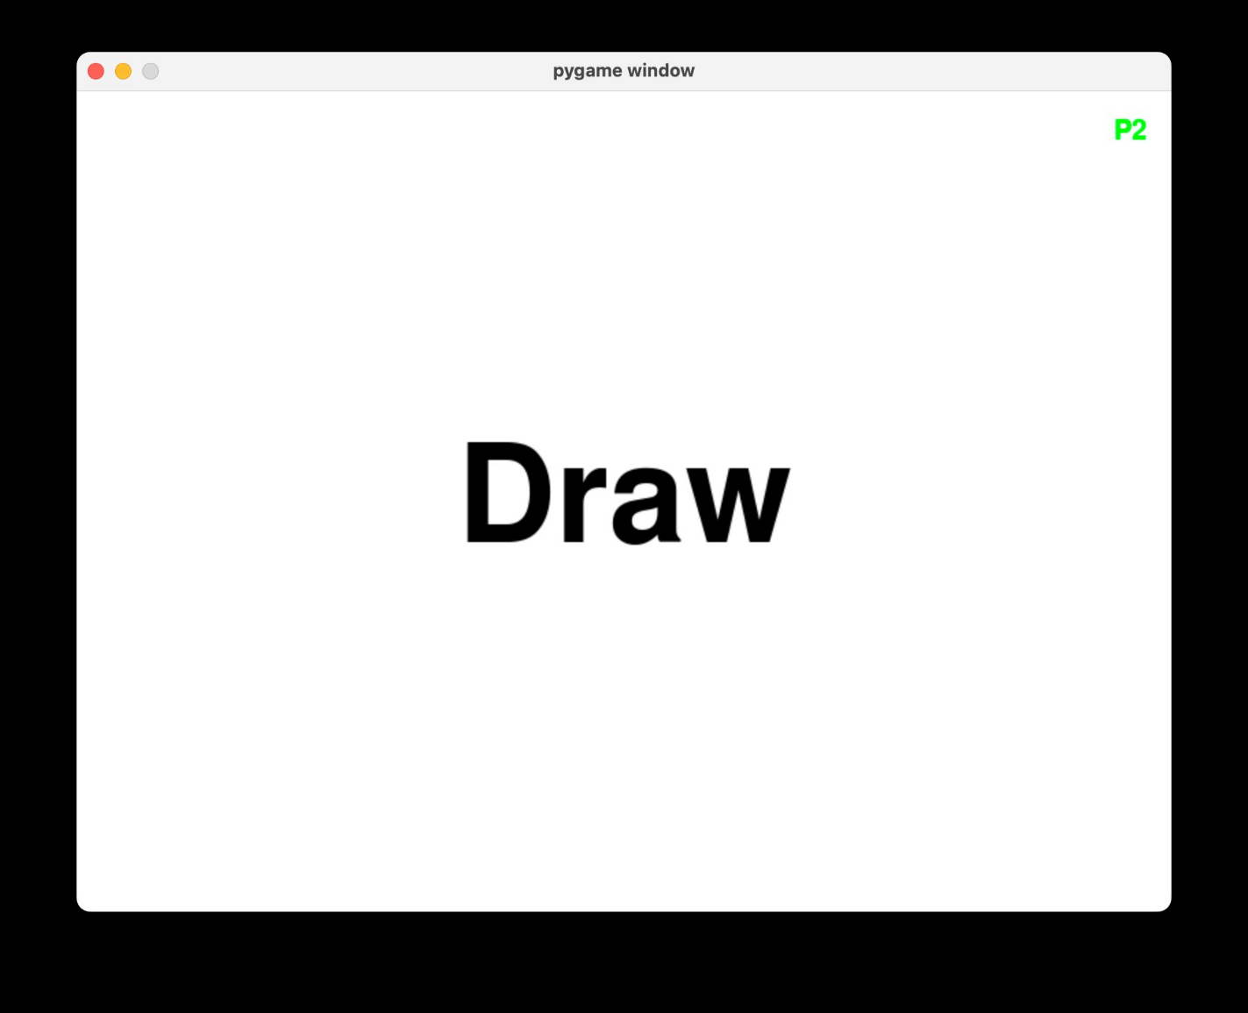
[NAME OF STUDENT]
Mock Screens
You scored 1
Player 1
Wins!
Description
Description
Result Screen
Winner Screen
8
Notes:
Poppins Light – 18 size

Slide 9
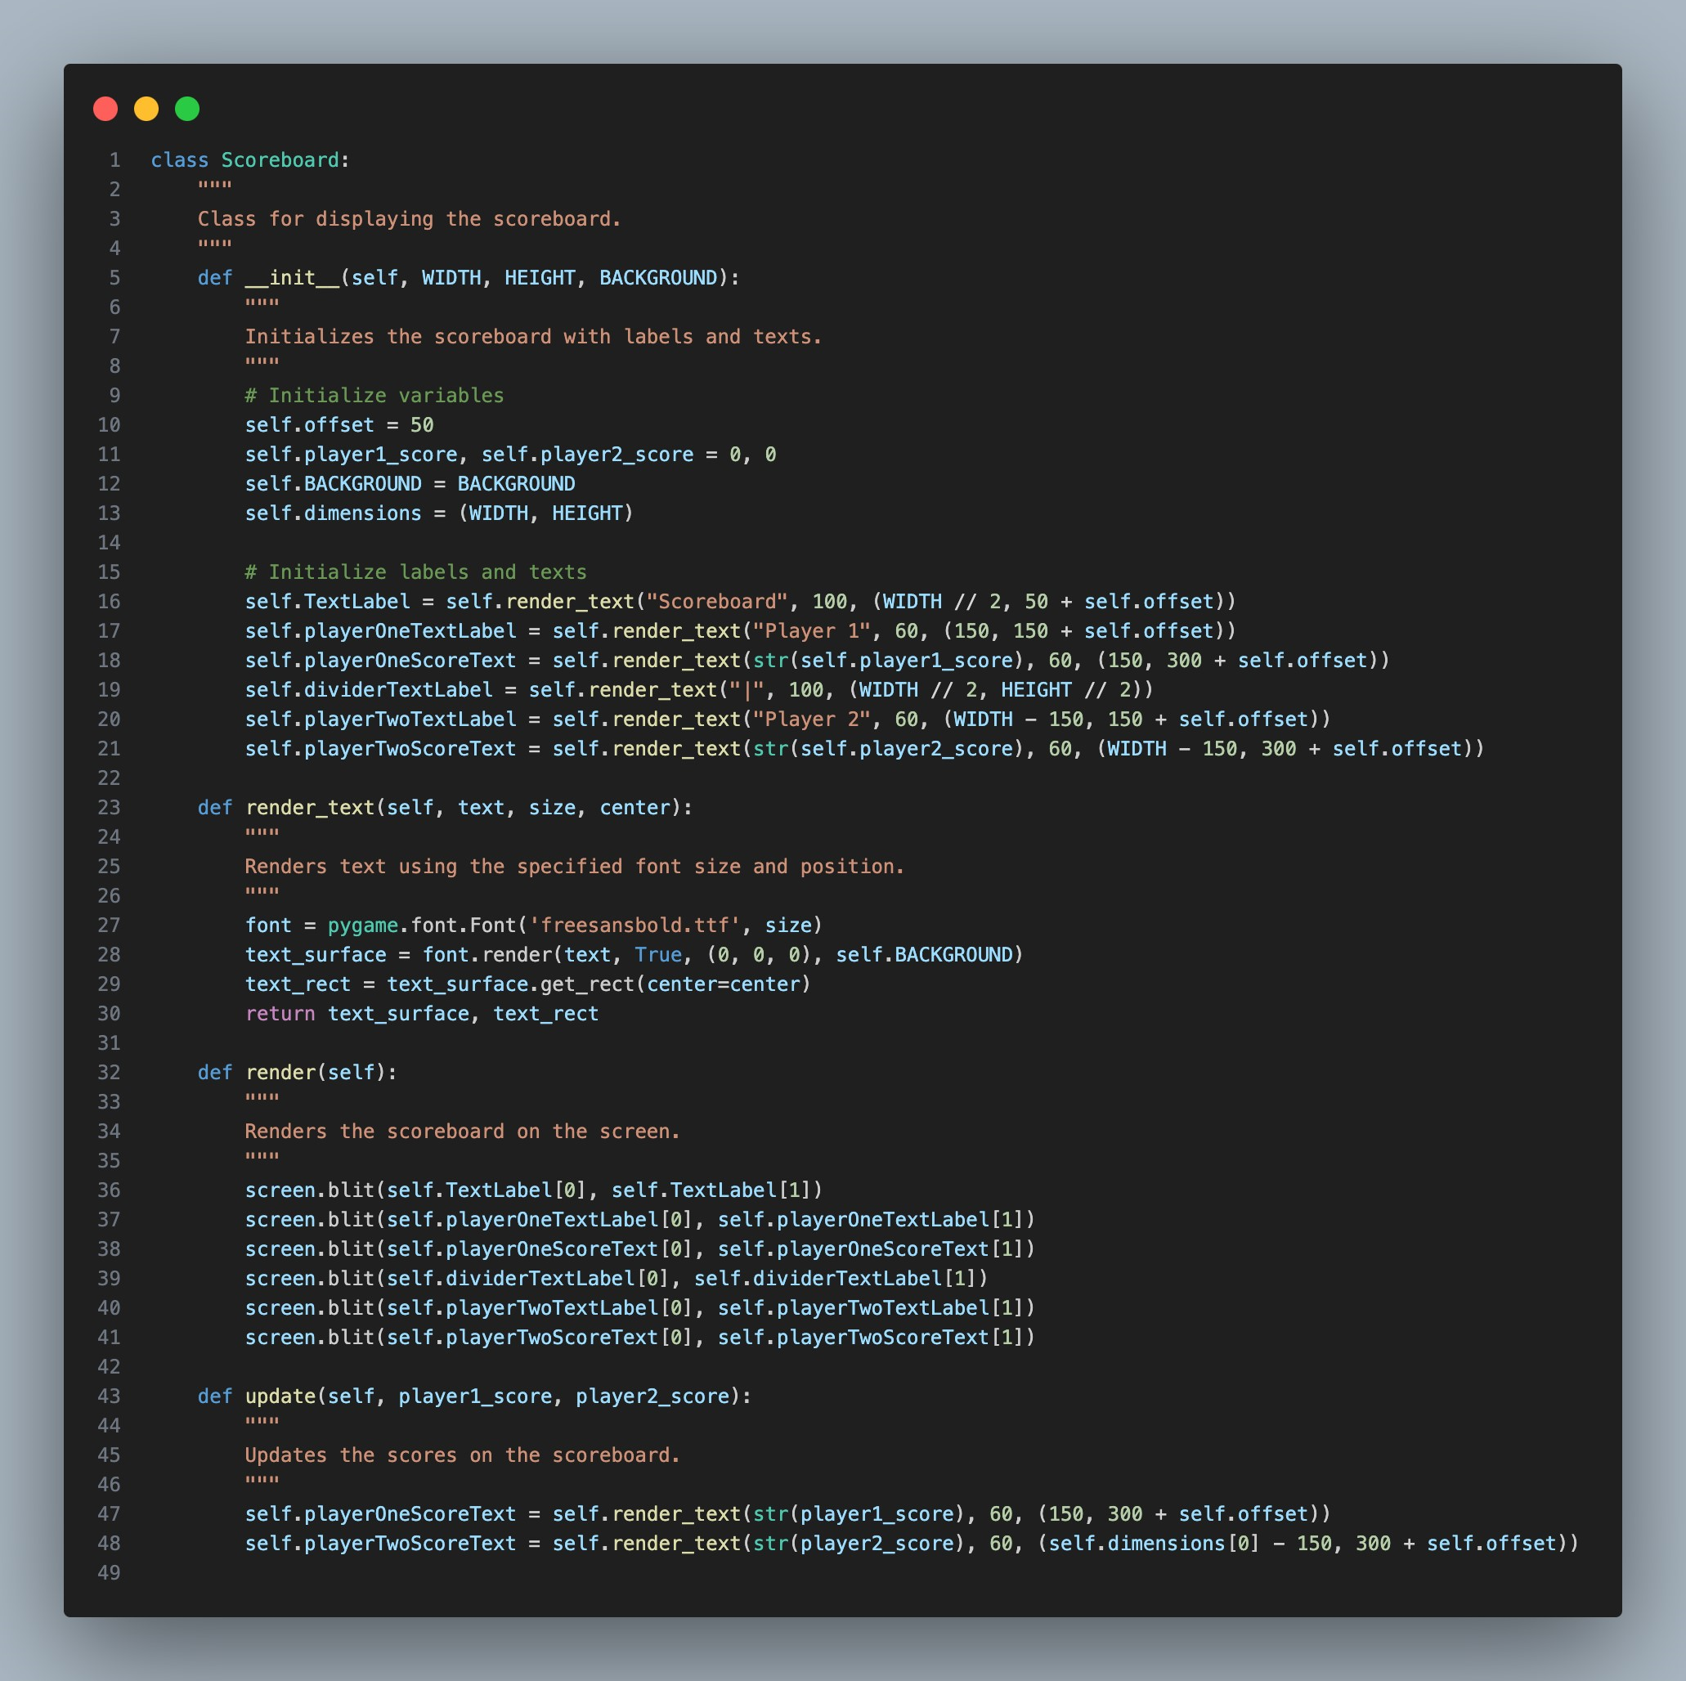
Scoreboard Screen
Displays player scores and labels.
Provides an overview of the current game state.
Elements include player names and their respective scores.
9
Scoreboard Screen
Notes:
Poppins Light – 18 size

Slide 10
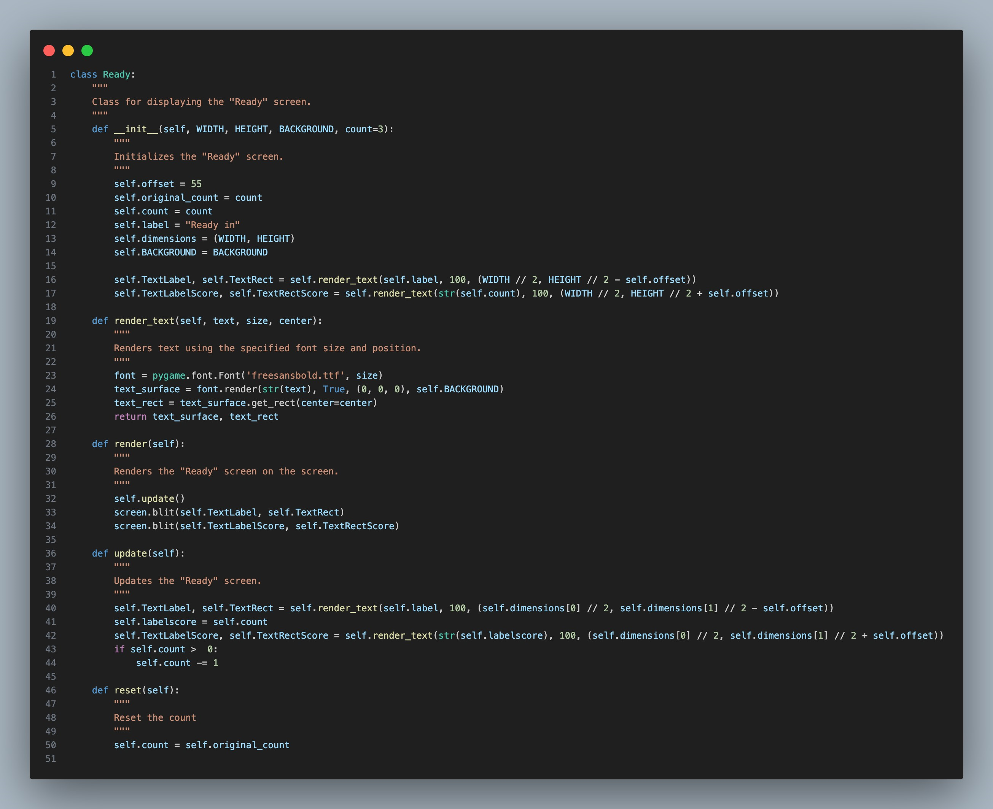
Ready Screen
Counts down to the start of the quiz.
Presents the label "Ready in" and the countdown timer.
Prepares players for the upcoming question.
Ready In
1
10
Ready Screen
Notes:
Poppins Light – 18 size

Slide 11
Y`
Gameplay
If Time Left > 0?
No
0
Loads the next question for every correct response
If wrong answer is given or time runs out, end gameplay.
Yes
No
Is Answer Given?
Yes
Is Answer Correct?
No
Yes
Score: 0
Time: 100
Increase Score by 1
Load next Question
Result Screen
Description
11
Gameplay Screen
Notes:
Poppins Light – 18 size

Slide 12
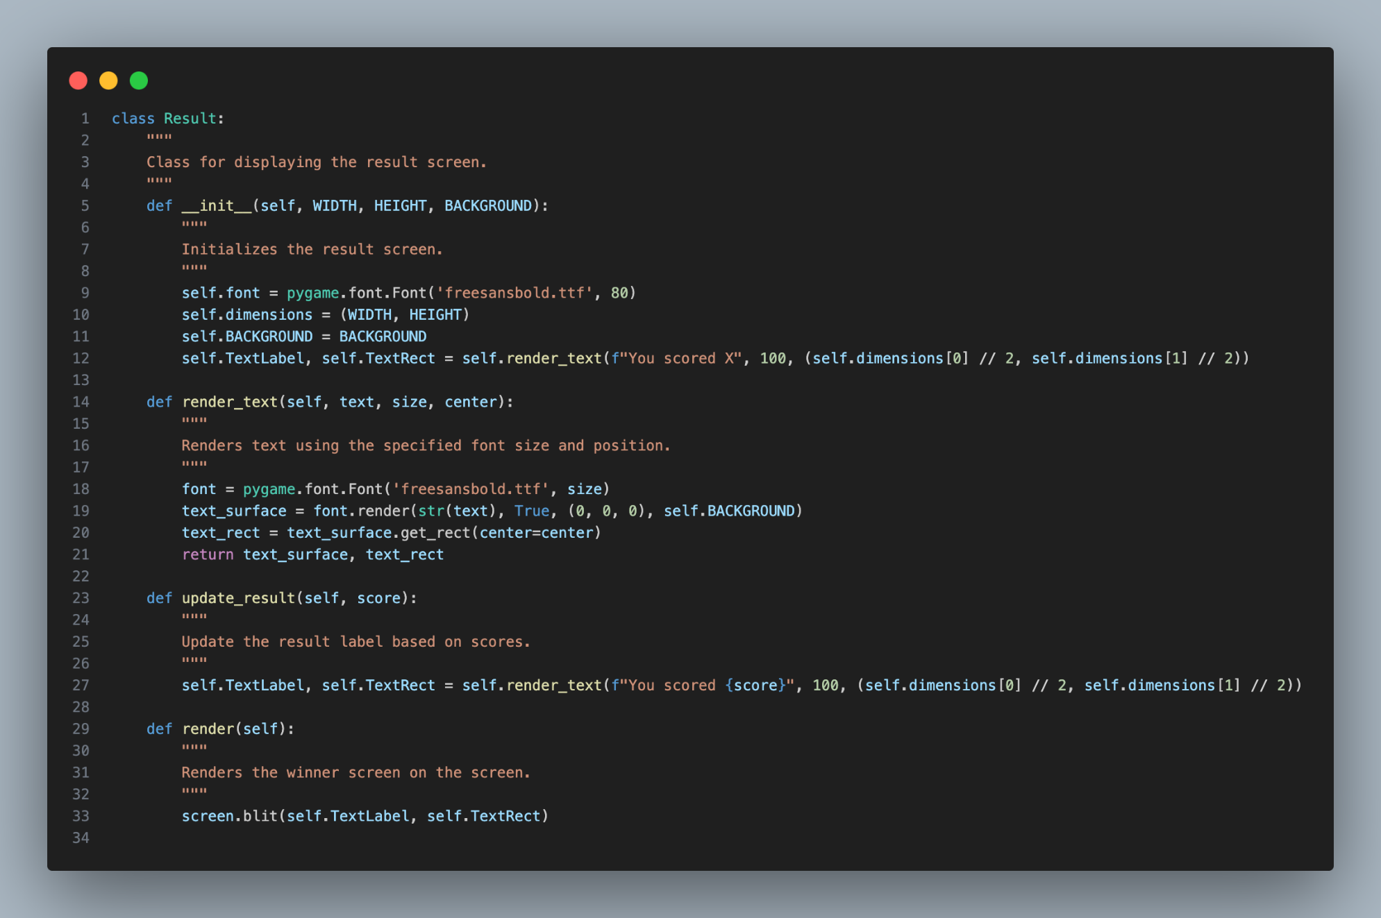
Result Screen
Shows the outcome of the player's answer.
Indicates whether the answer was correct or not.
Presents the label "You scored" and the score.
You scored 1
13
Result Screen
Notes:
Poppins Light – 18 size

Slide 13
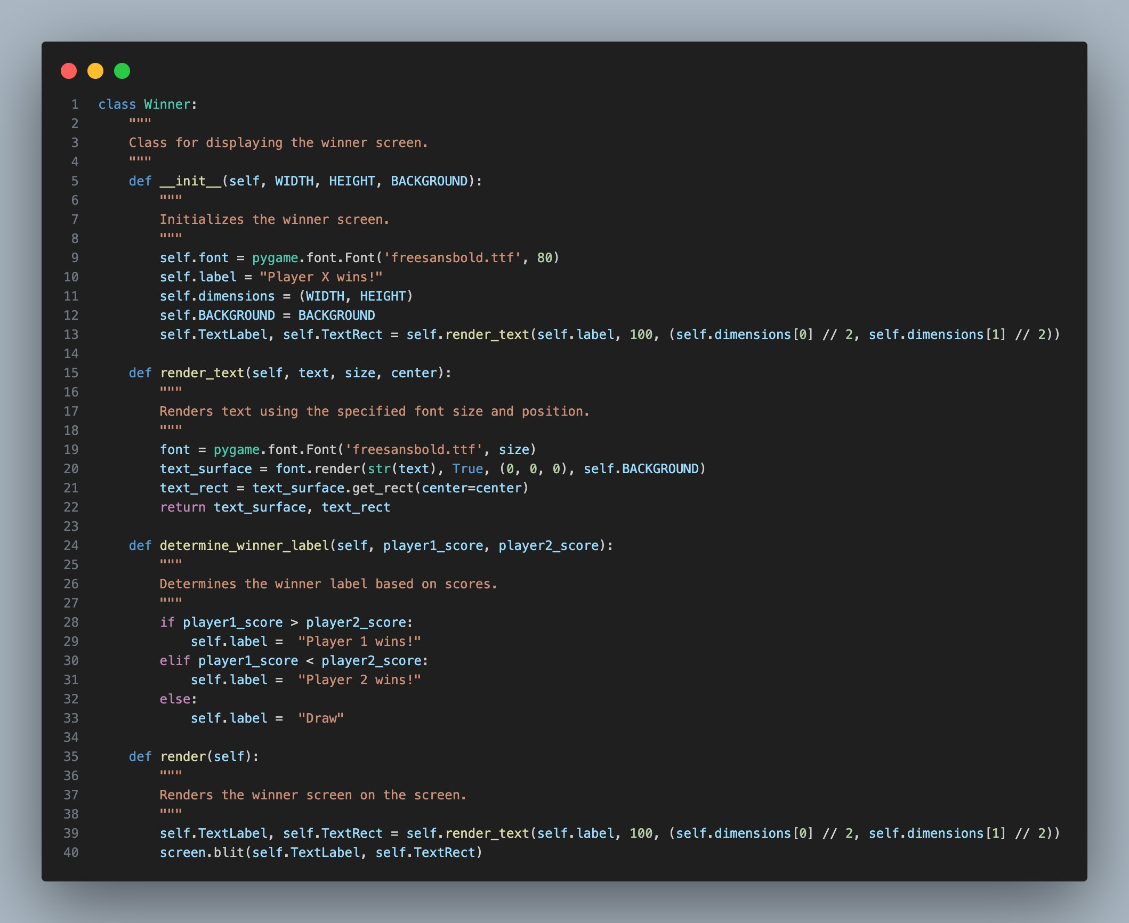
Winner Screen
Declares the winner of the game.
Displays the label "Winner" along with the winning player or a draw message.
Celebrates the victor of the quiz.
Player 1
Wins!
14
Winner Screen
Notes:
Poppins Light – 18 size

